Slide 1
The Volcano Optimizer Generator
Extensibility and Efficient Search

Slide 2
Background
Emerging database applications demand
  new functionality
  high performance
Volcano Project
  Provides efficient, extensible tools for query and request processing.
  For object-oriented and scientific database systems

Slide 3
Introduction
Performance must not be sacrificed
  Data volumes stored in database system continue to grow, need to support this
  In order to overcome acceptance problems
  Additional software layers counter-balanced by performance
Notes:
Optimization and parallelization are prime candidates
tools and techniques for optimization and parallization are crucial for the wider use of extensible database technology.

Slide 4
New Optimizer Generator
Search engine more extensible and powerful
Effective support for non-trivial cost models and for physical properties such as sort order.
Combines dynamic programming
Notes:
Dynamic programming has until now been used only for relational select-project-join optimization with goal-directed search and branch-and-bound pruning.
Compared with other rule based optimization systems, it provides complete data model independence and more natural extensibility.

Slide 5
Properties New Optimizer
Usability as a stand-alone tool
More efficient resource usage
  optimization time, memory consumption
Extensible support for physical properties
  Sort order, compression status
Notes:
Usable both in the Volcano project as well as other types of projects as stand alone tool
Efficient in both optimization time and in memory consumption for the search
Effective, efficient, and extensible support for physical properties such as sort order and compression status.
Permit use of heuristics and data model semantics to guide the search and to prune futile parts of the search space
Support flexible cost models that permit generating dynamic plans for incompletely specified queries

Slide 6
Properties of New Optimizer
Permit use of heuristics
  Guide the search and prune futile parts
Support flexible cost models that permit generating dynamic plans
  for incompletely specified queries
Data model independence

Slide 7
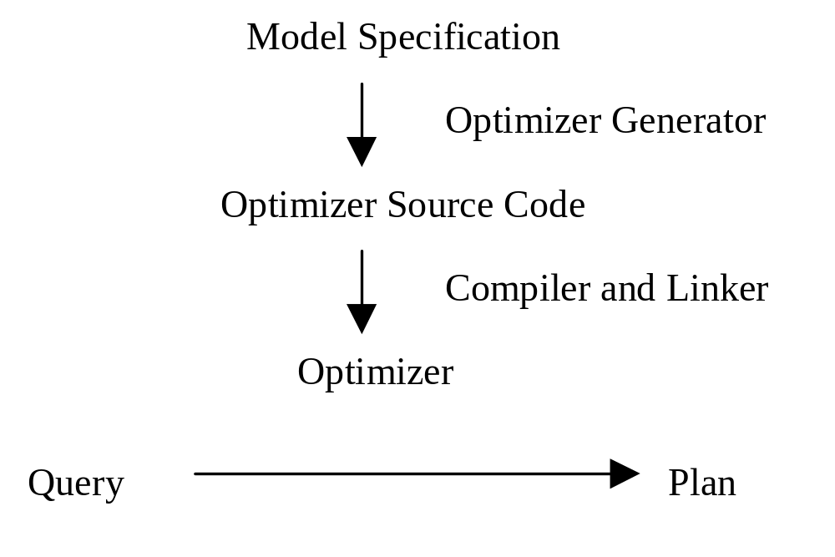
Generator Paradigm

Slide 8
Design Principles
Query processing based on algebraic techniques
  use transformations and cost-based mapping of logical algebra to algorithms
Rules
  identified as general concept to specify
    knowledge about patterns in a concise and modular fashion
    knowledge of algebraic laws as required for equivalence transformations
Notes:
Logical algebra translated into physical algebra.
Rules defined independently, translated independently.
The choices that the query optimizer can make to map a query into an optimal equivalent query evaluation plan are represented as algebraic equivalence

Slide 9
Design Principles
Optimizer choices represented as algebraic equivalences in generator’s input
  no intermediate levels
  search engine applies them suitably
Compiled rule set
Dynamic programming

Slide 10
Optimizer Operation
User queries specified as algebra expression of logical operators
Goal : Mapping of logical algebra to physical algebra
  Transformation, Implementation Rules (Pattern match, condition)
  multiple logical operators to single physical operator (join followed by projection)

Slide 11
Optimizer Operation
  Physical property vector used to summarize physical property of intermediate results
Enforcers (sorting, decompress)
  physical algebra that do not correspond with any logical operators
  purpose is to enforce physical properties

Slide 12
Properties
Properties describe results
  Logical properties (schema, size..)
  Physical properties (sort order…)
Physical properties summarized in a physical property vector
  optimizer implementor specifies

Slide 13
Optimizer Operation
Applicability Functions
    determine whether or not algorithm or enforcer can deliver logical expression w/ physical properties that satisfy physical property vector
    determine the physical property vectors that the algorithm’s inputs must satisfy
Cost function
    Cost : abstract data type
    estimate algorithm or enforcer’s cost

Slide 14
Optimizer Operation
Property functions
  determines logical and physical properties of logical and physical algebra expression
  one per each logical operator, algorithm, enforcer
Notes:
Property functions
Logical properties determined before optimization is performed
intermediate size
encapsulates selectivity estimation
Physical property determined after execution plan has been chosen
Consistency check with physical properties vector

Slide 15
Optimizer Input
Optimizer Implementor provides
  A set of logical operators
  algebraic transformation rules (condition code)
  a set of algorithms and enforcers
  implementation rules (condition code)
  ADT cost (functions for arithmetic and comparison)
  ADT physical property
  applicability function
  cost function
  property function

Slide 16
The Search Engine
Search engine and algorithms are central components of query optimizer
Search engine used with all optimizer
Search engine linked automatically with pattern matching and rule application code generated from data model description.

Slide 17
Dynamic Programming
Extends to general algebraic query and request optimization and combines it with a top-down, goal-oriented control strategy for algebras in which the number of possible plans exceeds practical limits of pre-computation.
Derives equivalent expressions and plans only for those partial queries that are considered as parts of larger subqueries.
Directed Dynamic programming - goal driven, backward chaining

Slide 18
Dynamic Programming
Partial optimization results used in later optimization decisions.
Reinitialized for each query currently
Prevent redundant optimization by capturing logical expressions and plans in hash table.

Slide 19
FindBestPlan
Logical expression, physical properties, and cost limit as input
First find in Hash table
  plan satisfying physical property vector
  return plan (cost limit?) + cost OR failure
If expression not optimized before, optimization begins

Slide 20
Optimizer Moves
Transformation rule
Algorithm that delivers logical expression w/ desired physical properties
Enforcer to permit additional algorithm choices

Slide 21
Search
Most promising move pursued
Exhaustive search currently
  in future subset of moves will be selected, determined and ordered by another function provided by the optimizer implementor
Cost limit used to improve search
  branch&bound pruning
  passed down in the optimization of subexpressions

Slide 22
Transformation Rule
New expression formed
Optimized with FindBestPlan
Hash table

Slide 23
Algorithm
Cost calculated by algorithm’s cost function
Applicability function determines the physical property vectors for inputs
Costs and optimal plans found by calling FindestPlan

Slide 24
Enforcer
Cost estimated by cost provided by optimizer implementor
Modify physical property vector
Optimize with FindBestPlan
Store interesting facts in hash table
  possible future use

Slide 25
Functionality and Extensibility
Distinction btw logical expressions and physical expressions
Ability to specify physical properties -> drive optimization
Algorithm is driven top-down
Cost is more general
Allow implementation of other search strategies

Slide 26
Search Efficiency and Effectiveness
Much more effective and efficient compared to earlier prototype

